Slide 1

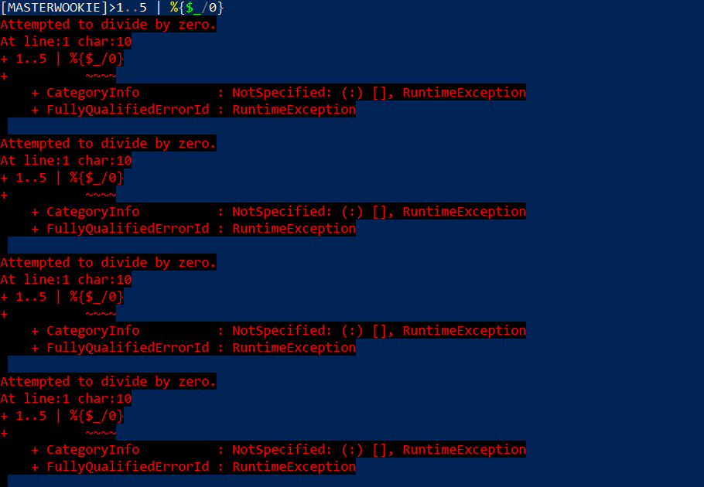
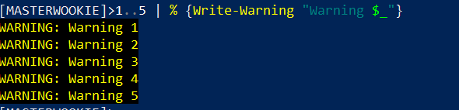
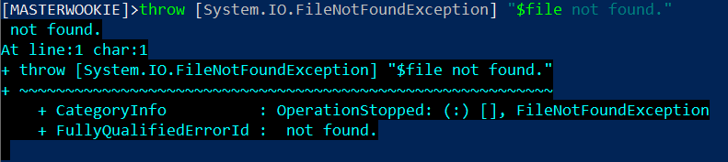
Errors, Warning, Exceptions Oh My!
Notes:
Errors, exceptions, and warnings, something every Systems administrator deals with daily. In fact, one evening while I was performing my oncall duties of manually logging on to an application that keeps track of ATM Transactions, the queue was well over the 150 transaction threshold, luckily at that time, we were performing an upgrade, which was causing the queue to back up temporarily until the upgrade completes.

Slide 2
PowerShell with SQL Statement Data Gathering?
Notes:
Why should you care and what benefit would you get from this?

Slide 3
Agenda
LynxGate Automation Process
SQL Server Module
ITOpsVerification Module
Demo

Slide 4





Who is Bruce Stump
Systems Administrator
Teacher’s Credit Union
GitHub
LinkedIn
Twitter
Notes:
Star Wars Fan, so you may see some references to Star Wars.
Also like to point out that we use the powershell that comes with the Windows Server OS in our environment, which is Powershell 5.1.
I’m going to take you through how we solve a problem we had by Automating a manual process. This may not be the best option, just offering another option. It will depend on your environment and what resources you have available.

Slide 5
Source Files for Presentation (GitHub)
https://github.com/bstump101/PowerShellWithSQLStatementDataGathering

Slide 6
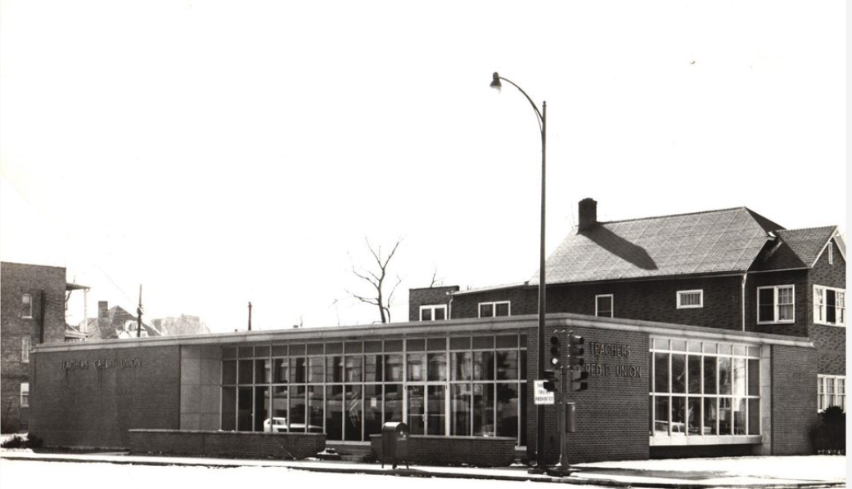
Teachers Credit Union is a not-for-profit financial institution in Indiana and southwest Michigan that was founded in 1931 in South Bend, Indiana.
https://www.tcunet.com/
Notes:
I’d also like to recognize my employer since they so gaceously help pay for my way to this conference.

Slide 7
Systems Administrator Role
Applications
Processes
Services
Databases
Networking
Etc.
What if service depends on transactional data?
Notes:
Systems Administrator where’s many hats. One task we perform is monitoring, what if we need specific data from database to determine if there is an issue.

Slide 8
Problem
Monitor ATM Transactions

Slide 9




Possible Solutions

Slide 10
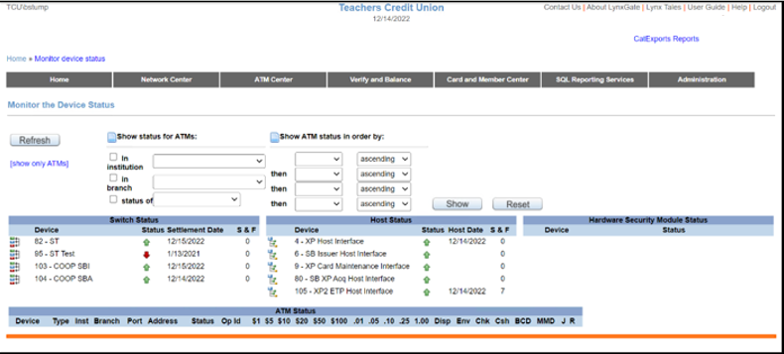
LynxGate Interface

Slide 11
SQL Server Module
Install-Module SQLServer
Import-Module SQLServer
Invoke-SqlCmd

Slide 12
ITOpsVerification Module
Contains LynxGate Cmdlets
Install-Module ITOpsVerification
Import-Module ITOpsVerification
Demo

Slide 13
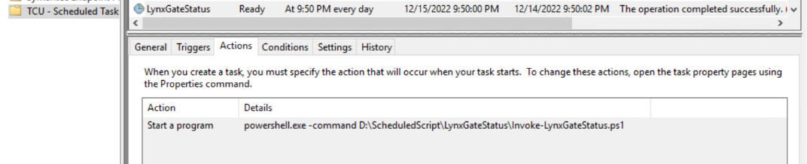
Scheduled Task – Actions

Slide 14
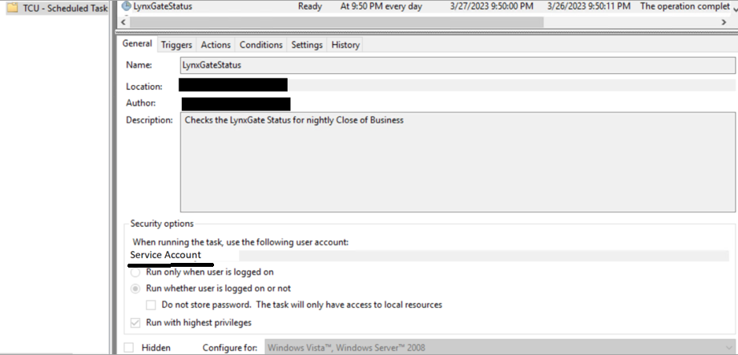
Scheduled Task - General
Notes:
Redacted some fields for security reasons.

Slide 15
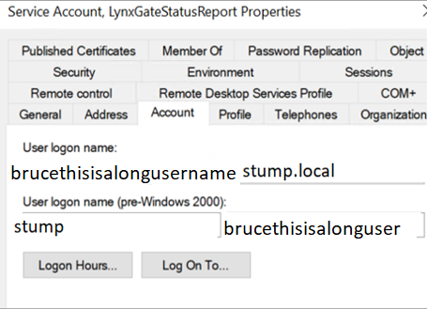
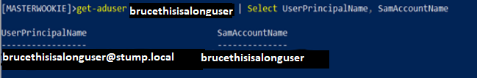

LynxGate Service Account

Slide 16
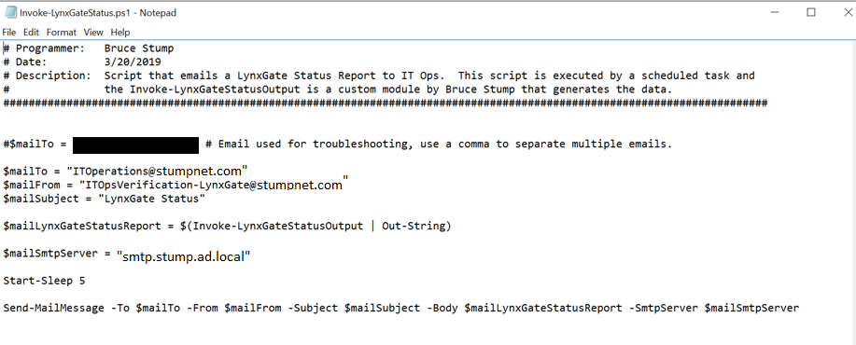
Invoke-LynxGateStatus.ps1
Notes:
Could of used splatting.

Slide 17
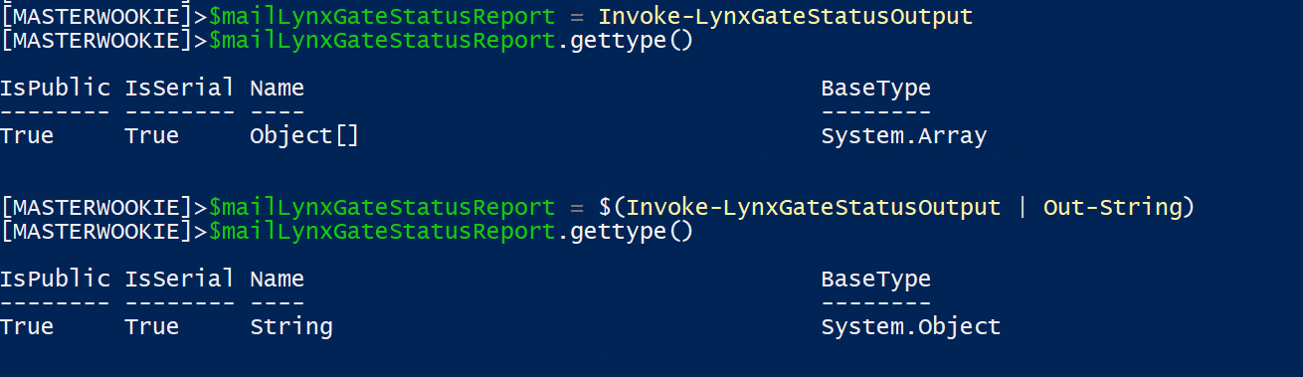
$mailLynxGateStatusReport

Slide 18
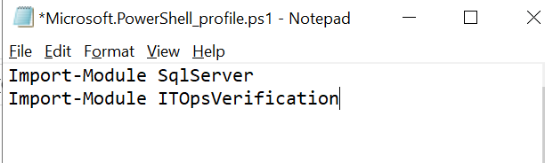
Profile
C:\Users\<Service Account Name>\Documents\WindowsPowerShell

Slide 19
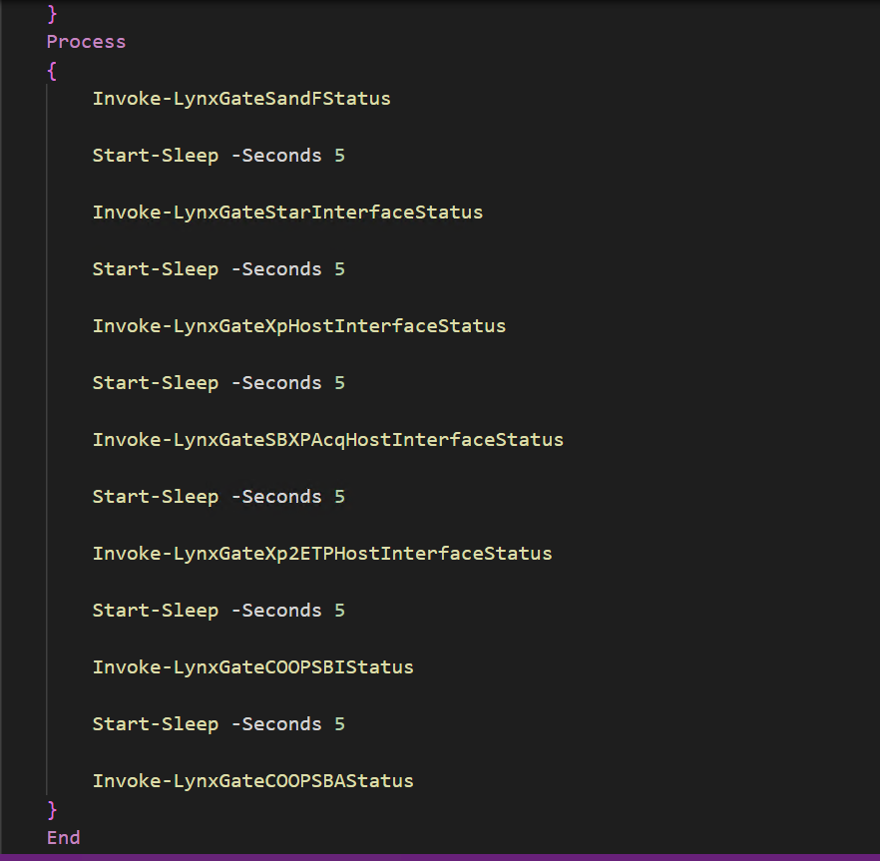
Invoke-LynxGateStatusOutput

Slide 20
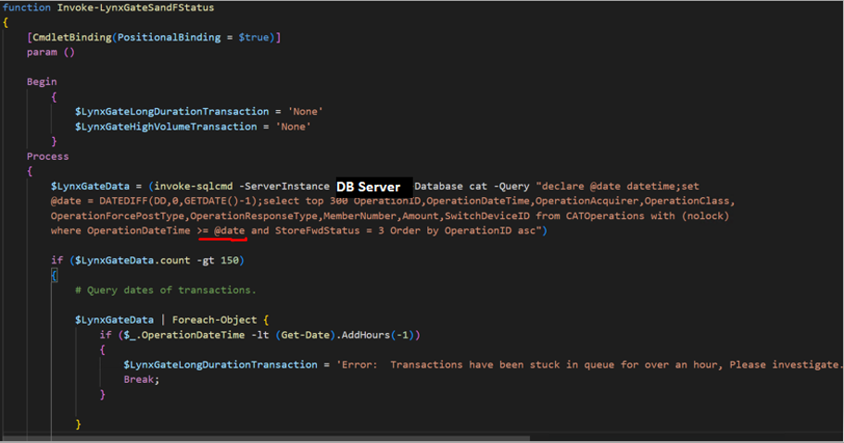
Invoke-LynxGateSandFStatus

Slide 21
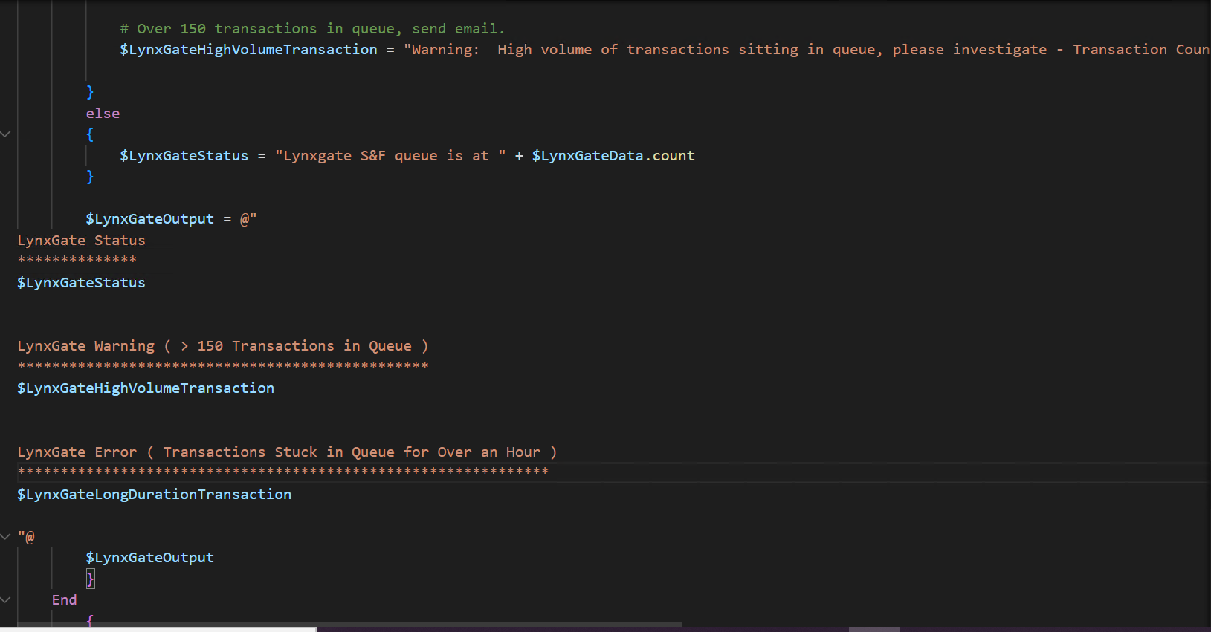
Invoke-LynxGateSandFStatus 2

Slide 22
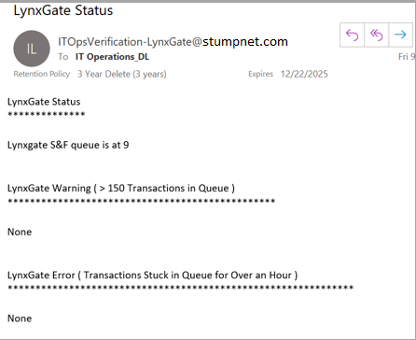
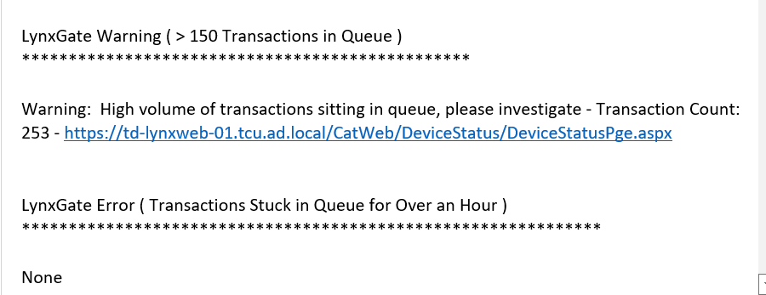
Invoke-LynxGateSandFStatus (Sample Email)

Slide 23
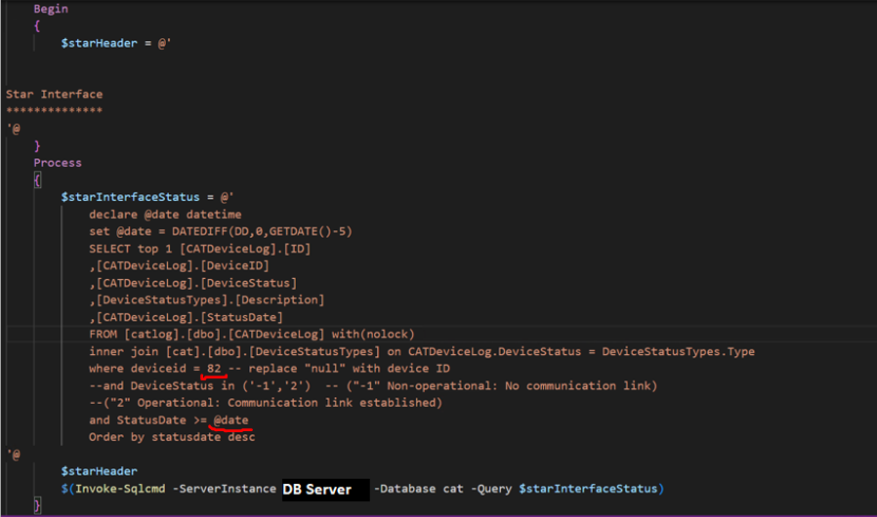
Invoke-LynxGateStarInterfaceStatus

Slide 24
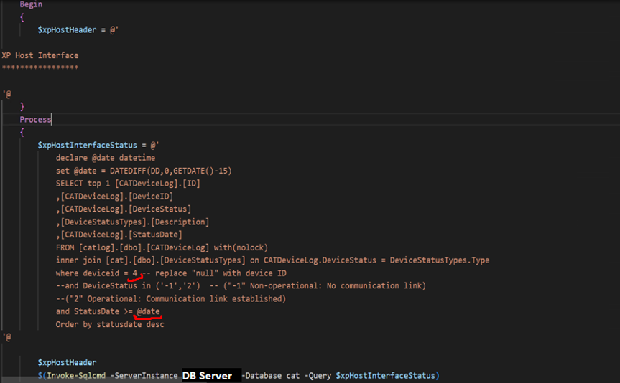
Invoke-LynxGateXpHostInterfaceStatus

Slide 25
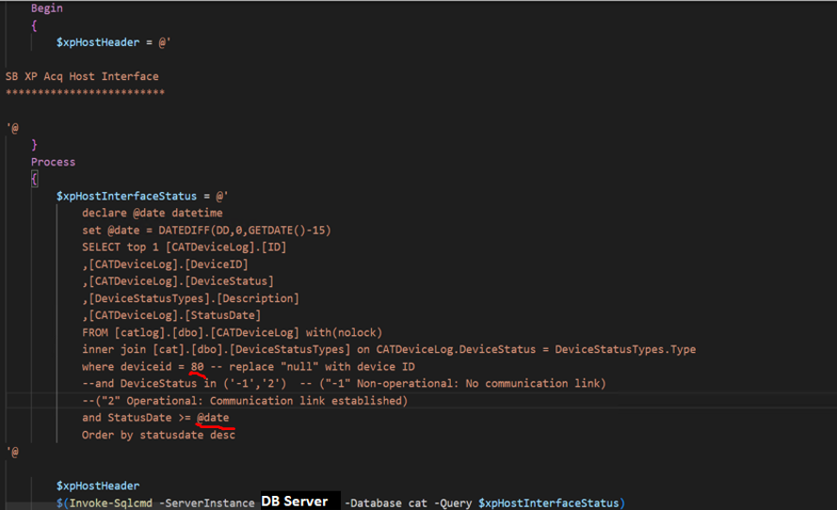
Invoke-LynxGateSBXPAcqHostInterfaceStatus

Slide 26
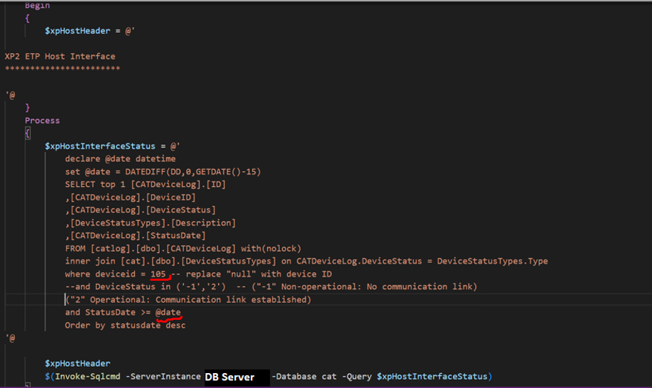
Invoke-LynxGateXp2ETPHostInterfaceStatus

Slide 27
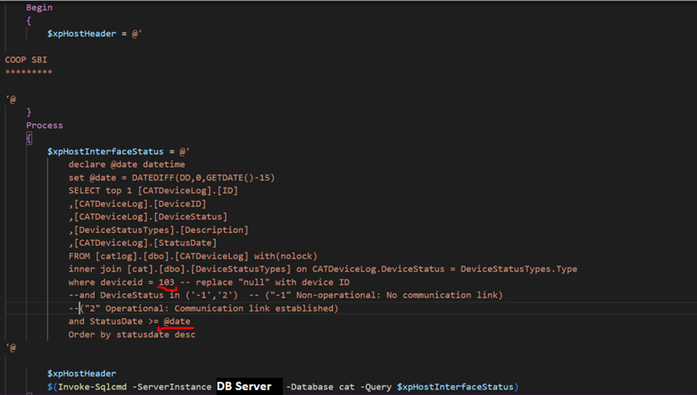
Invoke-LynxGateCOOPSBIStatus

Slide 28
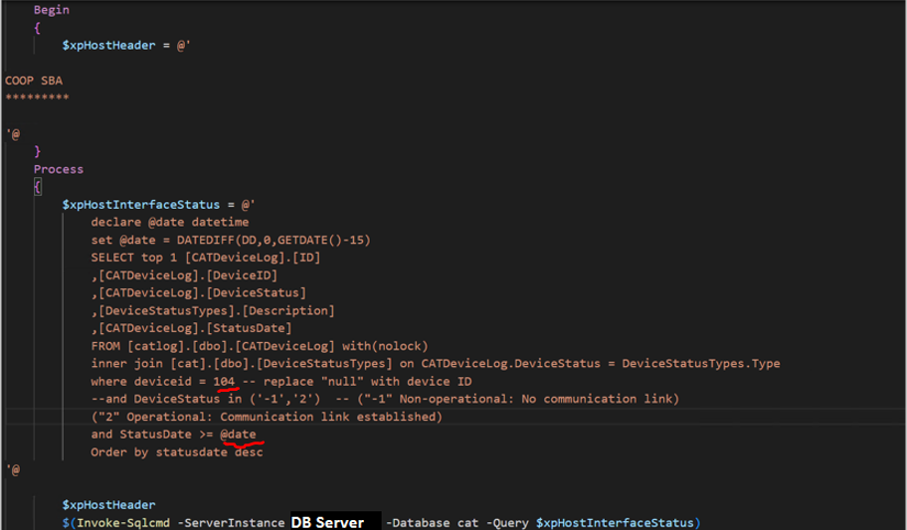
Invoke-LynxGateCOOPSBAStatus

Slide 29
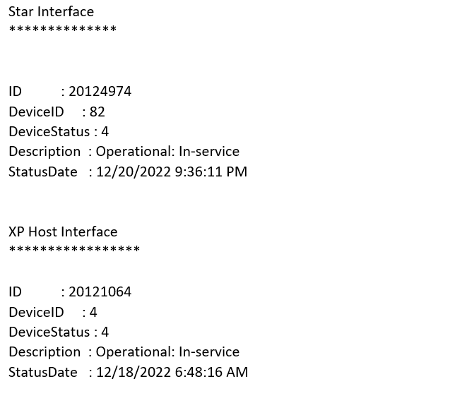
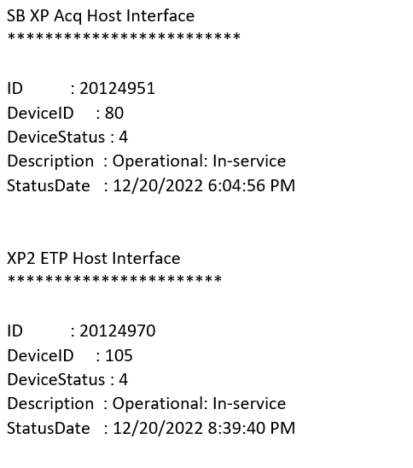
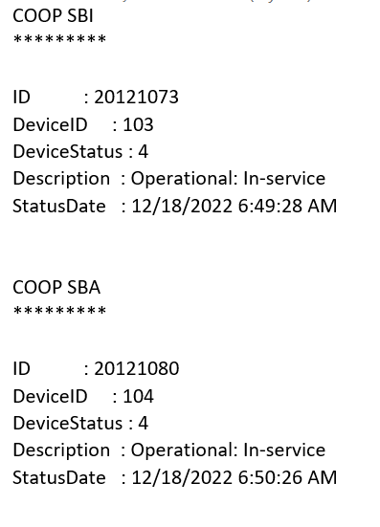
More Sample Emails

Slide 30
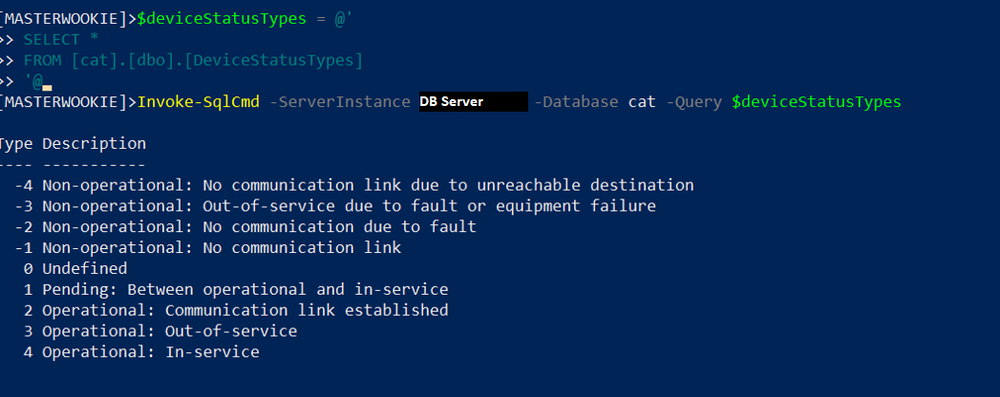
Device Status Types

Slide 31
Notification
PagerDuty

Slide 32
PSHSummit2023Demo

Slide 33
Thanks!
brucestump@gmail.com

